Slide 1

SYMPTOM BASED DISEASE PREDICTION
TEAM MEMBERS:
LAKSHMI MOUNIKA B
OAM CHANDRA LAASYA TUMMALA
RAKESH REDDY YENNAM

Slide 2
INTRODUCTION
Project Objective:
Build a predictive system for preliminary diagnosis and preventive measures using symptom data.
Integrate LSTM, ANN, and Feed-Forward neural networks to classify diseases based on user-reported symptoms.
Problem Statement:
Symptom progression prediction for early diagnosis and prevention.
Risk assessment and advice on precautions.

Slide 3
DATASET OVERVIEW
DATASET | DESCRIPTION | PURPOSE
DATASET.CSV | 4900 rows of data which contains disease and the followed symptoms ranging from 1-17 | Train and validate the LSTM model to recognize symptom patterns
SYMPTOM_SEVERITY.CSV | Severity cores associated with symptoms, useful for weighting risk | Enhance diagnostic accuracy and assess urgency
SYMPTOM_DESCRIPTION.CSV | Description of potential conditions associated with symptoms | Provide informative response and aid in user understanding
SYMPTOM_PRECAUTION.CSV | Preventive measures linked to various symptoms and conditions | Offer precautionary advice post-diagnosis

Slide 4
METHODOLOGY
Data Preprocessing:
01
Tokenization and padding of symptom text.
Label encoding for disease categories.
Model Architecture:
03
Sequential models with LSTM, ANN, and Feed-Forward architectures.
Regularization techniques (L2 regularization, Dropout) to prevent overfitting.
Training Process:
02
Split dataset into training and test sets (80%/20%).

Slide 5
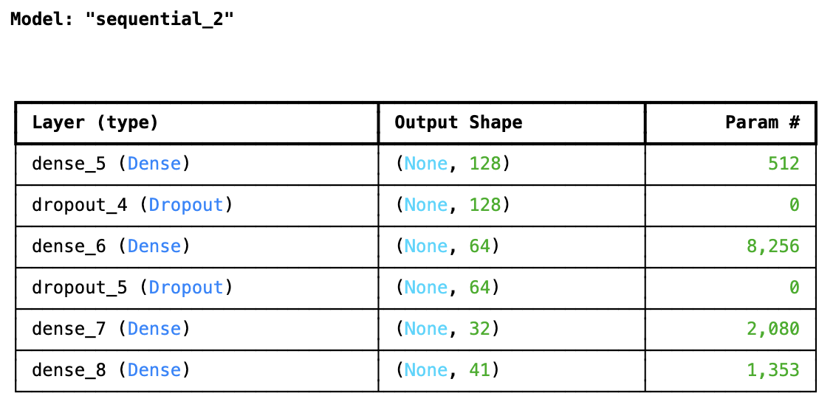
MODEL1: SIMPLE FEED FORWARD NETWORK

Slide 6
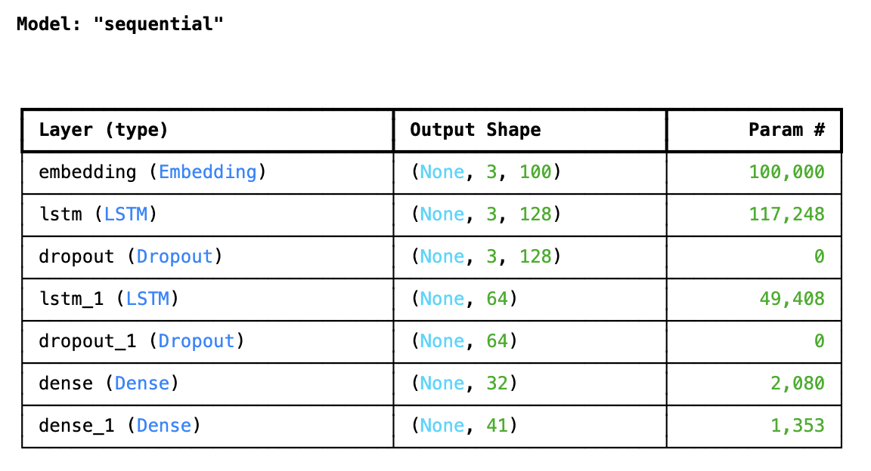
MODEL 2: LSTM

Slide 7
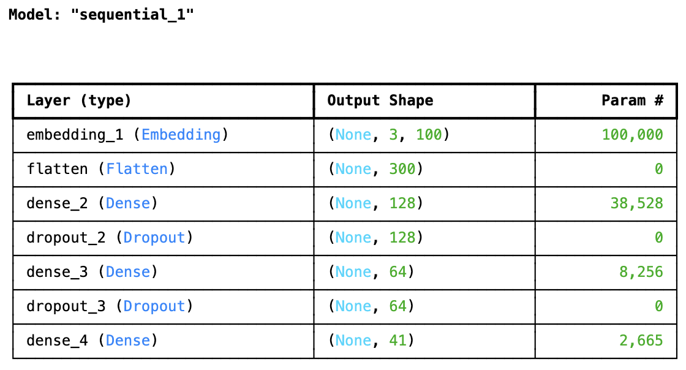
MODEL 3: ANN

Slide 8
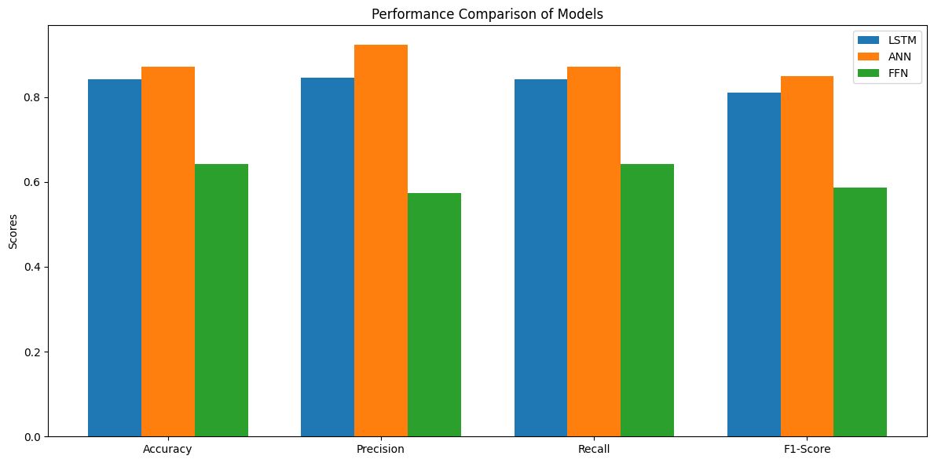
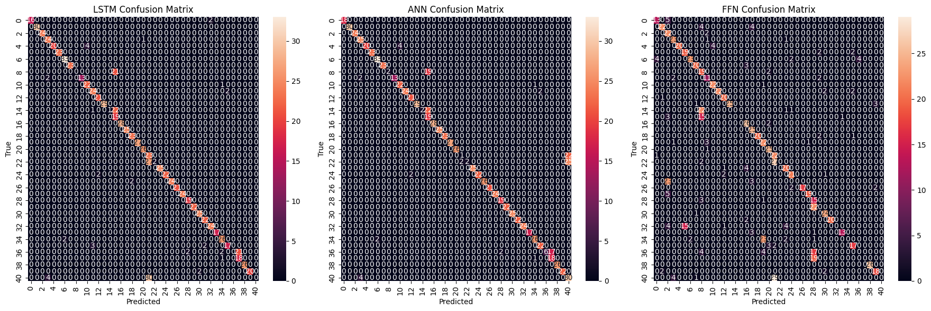
PERFORMANCE METRICS

Slide 9
PERFORMANCE METRICS
Model | Accuracy | Precision | Recall | F1-Score | ROC-AUC
LSTM | 0.8577 | 0.9006 | 0.8577 | 0.8323 | 0.9958
ANN | 0.8689 | 0.9237 | 0.8689 | 0.8442 | 0.9960
FFN | 0.6209 | 0.5218 | 0.6209 | 0.5482 | 0.9581

Slide 10
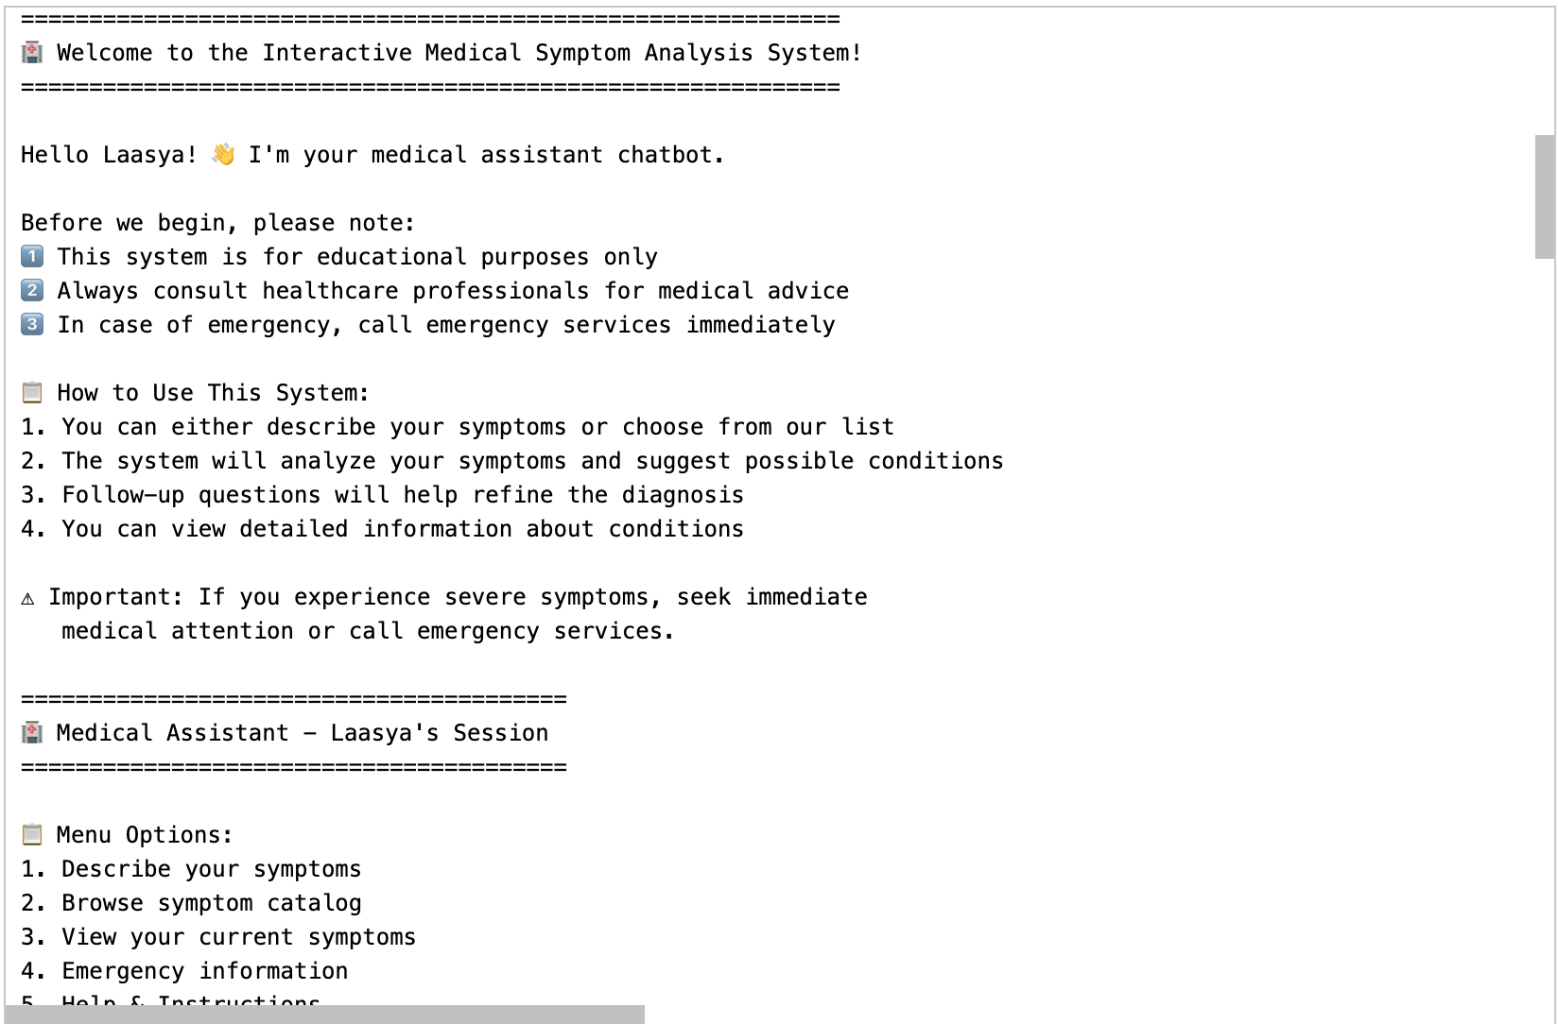
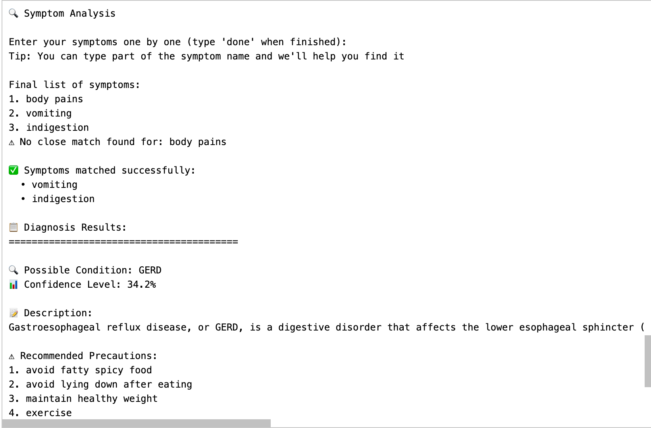
REAL-TIME APPLICATION

Slide 11
CHALLENGES
Data Challenges:
Text-based input with variations in symptom descriptions.
Small dataset size (4900 rows).
Model Challenges:
Overfitting due to small dataset.
Balancing between model complexity and generalization.
Performance Challenges:
Ensuring a robust model with consistent predictions across different classes.

Slide 12
FUTURE SCOPE
Improvement of Data:
Expand the dataset with more user reports to improve generalization.
Model Enhancements:
Experiment with Transformer models like BERT for symptom classification.
User Interaction:
Implement real-time symptom tracking and progression prediction in a chatbot interface.
Precautionary Recommendations:
Implement more personalized, dynamic precautionary advice based on model predictions.

Slide 13

ANY QUESTIONS?

Slide 14

THANK YOU

